Slide 1
College name: Vishwakarma Institute of Technology Team name: M square Team leader name: Mohit Garg. Team members name: 1. Mohit Garg. 2. Manasi Kamble. Problem statement: In the wake of the COVID-19 pandemic, many families have experienced the devastating loss of an earning family member, leading to a myriad of challenges. To address these post-COVID problems, we aim to develop a comprehensive web application that will cater to the needs of the victims' families.

Slide 2
Proposed solution
We are focused mainly on Creating a Web Portal, which will be able to give Financial & Social Support, Child Care for Working Women, Jobs for Women,Technical Support for Womens.

Slide 3
Objectives
Ensuring Transparency and Accountability in the Services.
Making it easy for users to find best Service provider.
Ensuring that the platform is accessible to citizens from all socio -economic background.
Multilingual Support : Marathi , English , Hindi.

Slide 4
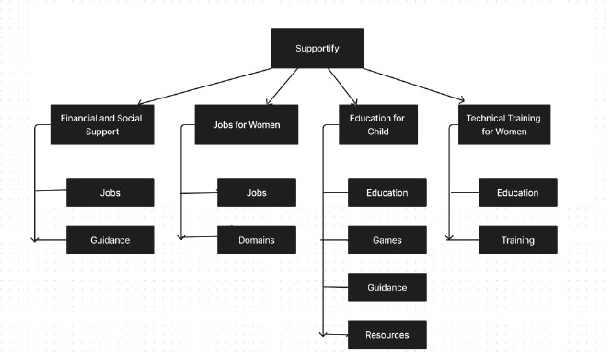
Architecture

Slide 5
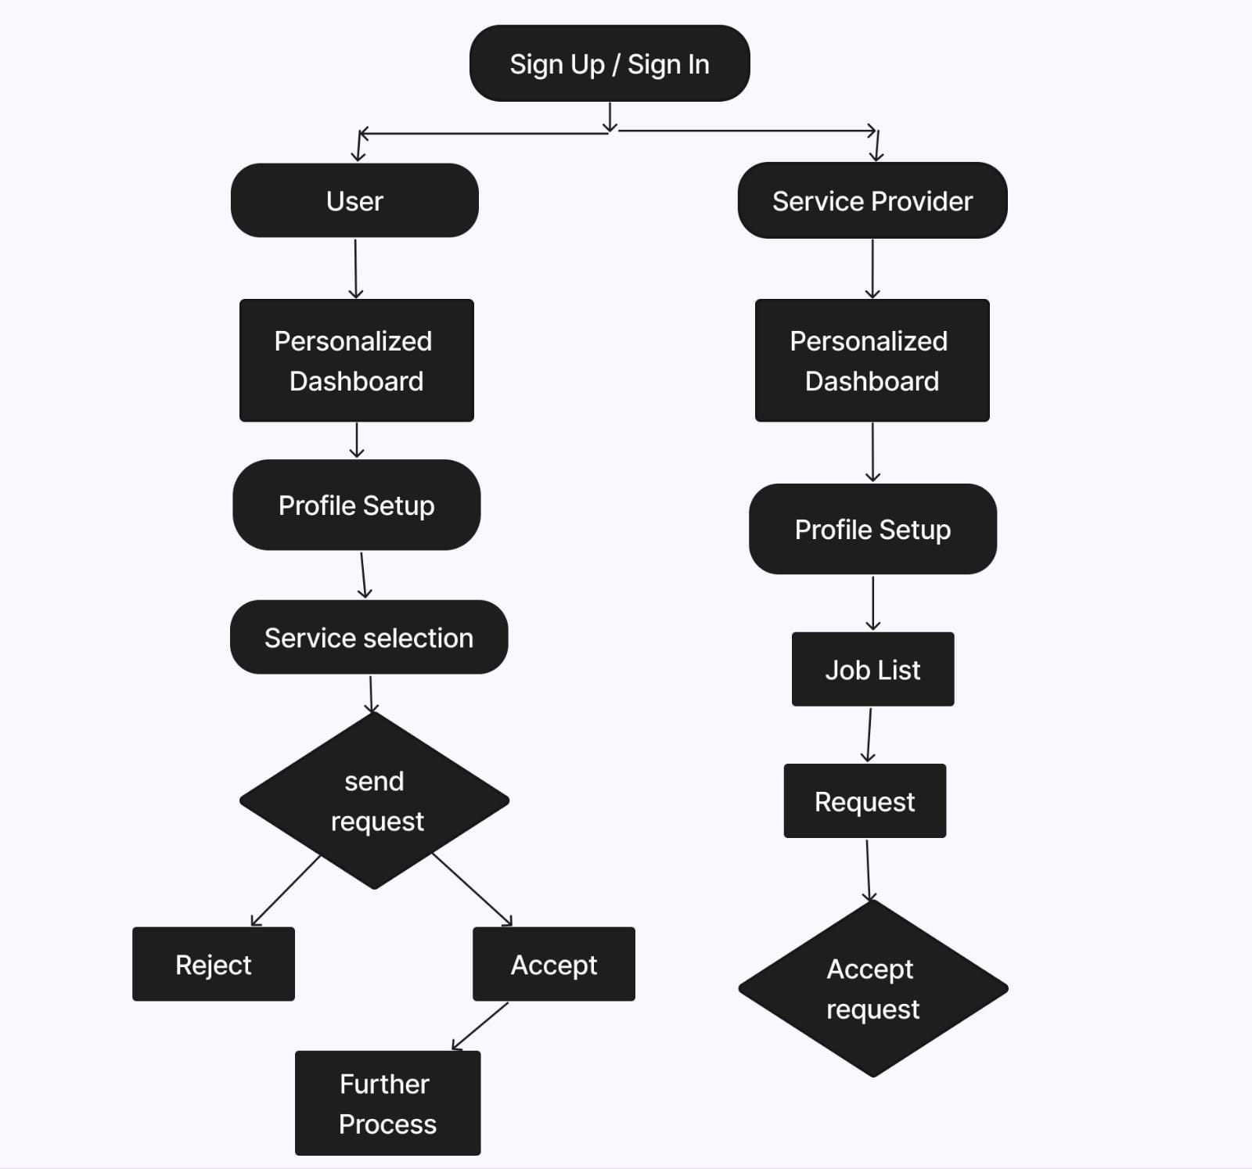
Architecture

Slide 6





Tech Stack

Slide 7
Applications
Facilitate Accessibility: By centralizing financial support information, child care services, and job opportunities, the portal helps users access crucial resources in one location, eliminating the need to navigate multiple platforms.
Empower Users: Through informative content, personalized recommendations, and interactive features, the portal empowers users to make informed decisions about their finances, childcare, and job prospects.
Support Community Building: The inclusion of community features and support groups fosters a sense of belonging and emotional support for those facing loss and adversity.
Promote Economic Recovery: By connecting job seekers with employment opportunities and employers with qualified candidates, the portal plays a role in the economic recovery post-pandemic.

Slide 8
Conclusion
In conclusion, the development of a web portal designed to address the needs of families affected by the loss of an earning family member in the wake of the COVID-19 pandemic, along with accommodating service providers, is a vital and compassionate initiative.

